Slide 1
Soda and Sugar Tax Policies
September 22, 2016
Analysis by Sara Lopez and Adam Gallagher

Slide 2
Soda and Sugar Tax Policies - Public Narrative
News article network with 1941 stories. Colored by clusters. Sized by degree.
The soda and sugar tax public narrative is highly location-centric, creating distinct conversations that tie back to centrally shared concerns like corporate responses and lasting effects.
Source: Quid®

Slide 3
Legislation Breakdown
Jurisdiction | Proposed | Initiative/Legislation | Proponents | Opponents | Enacted?
Mexico – National | September 2013 | 10% per liter tax on all soft drinks, focus on carbonated drinks Part of President Nieto’s fiscal bill package Intention to reduce number of patents with diabetes & cardiovascular disease & lower spending of public health care system. | Tax will incentivize citizens to drink less soda Reduce public health care spending on diabetes treatment Reduce obesity rate of Mexico, one of the highest globally | Tax will lead to loss of jobs for sugar industry workers No proof that tax will reduce consumption of sugar Bill is influenced by international stakeholders and lobbyists | October 2013: $1 MXN per liter tax on sodas and 5% tax on junk food.
Berkeley, California - Municipal | November 2014 ballot measure | Tax of one cent per ounce on distributors of specific sugar-sweetened beverages such as soda, sport & energy drinks, sweetened ice teas Excludes drinks like milk, fruit juice, and diet sodas. | Tax will help reduce public health issues of obesity and diabetes, especially in child population Increase awareness when purchasing sugary drinks | Tax will hit low income demographic the hardest Overreaching paternalistic act of the government Will increase the cost of groceries | Approved November 4, 2014, took effect January 1, 2015.
The issue first rose to prominence when it became a national headline in Mexico, and immediately became a polarizing topic. Conversely, Berkeley's unique demographics led to a landslide win a year later.

Slide 4
Legislation Breakdown
Jurisdiction | Proposed | Initiative/Legislation | Proponents | Opponents | Enacted?
United Kingdom - National | March 2016 | Part of the 2016 UK budget Beverage manufacturers to be taxed according to volume of sugar sweetened beverages Pure fruit juice, milk, and small manufacturers to be excluded Revenue to fund sport in primary schools | Tax will reduce obesity, especially childhood obesity Help fund sport and exercise education in primary schools | Tax seeks to over simplify health issues - sugar alone will not be sufficient to address obesity Criticism over the paternalistic, overreaching of the government to dictate citizen’s dietary choices | Planned to come into effect in 2018.
Philadelphia, Pennsylvania - Municipal | June 2016 City Council Budget Hearing | Tax of three cents per ounce on all sugar-sweetened beverages (including glucose, corn syrup), but not diet sodas, Generate revenue for city programs, Pre-K education, and to help fight obesity of city residents | Tax is estimated to generate $91 million in revenue over the subsequent year Will fund the city programs (expanded Pre-K, park improvements, increase city fund) Would improve public health of residents | Tax will hurt local business owners and grocers Loss of jobs because it will lead to Coca-Cola and Pepsico operations being pulled from the city | Approved June 16, 2016.
In Philadelphia, the tax was positioned as a revenue-earner instead of a public health initiative, which could be a contributing factor to the high level of criticism it received.
Source:

Slide 5
Pepsico & Coca-Cola’s Footprint in Public Narrative
News article network with 1941 stories. Colored by company primary mention. Sized by degree.
 | Company Primary Mention
● | N/A | 86%
● | Coca Cola | 10%
● | Pepsico | 3.3%
● | Coca Cola; Pepsico | 0.26%
Coca-Cola has been more prominently portrayed as a key player in the debate around the pros and cons of the soda taxes. The little overlap between the two brands suggests that articles generalized the soda industry by focusing on one corporate name.
Source: Quid®

Slide 6
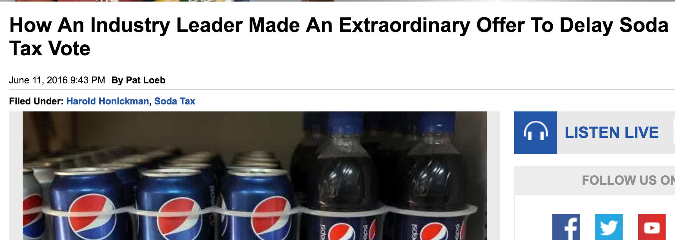
Top Companies by Social Sharing
News article bar chart with 308 stories. Colored by clusters.
Coca-Cola was heavily featured in articles that were more frequently shared online. Many of the most shared articles were heavily critical of the soda industry, including articles that compared the soda companies to Big Tobacco.
Source: Quid®

Slide 7
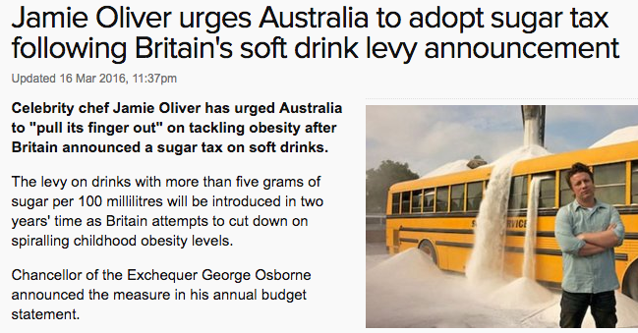
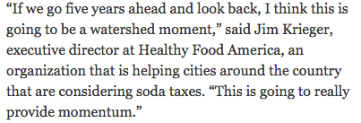
Key Individuals
Jamie Oliver – Oliver, the British celebrity chef, has made global efforts to have local governments pass taxes on sugary drinks. Oliver owes his high influencer ranking due to frequent appearances in leading global outlets like the BBC, Xinhua News Agency, ABC News and NEWS.com.au.
Influencer | Role | Influencer Score*
Jim Kenney | Philadelphia Mayor | 7007.15
Michael Bloomberg | NYC Mayor | 3614.1
Jamie Oliver | Health Advocate | 3308.65
George Osborne | UK MP | 2581.65
Michael Nutter | Former Philadelphia Mayor | 1901.45
David Cameron | Former UK PM | 1663.8
Jim Krieger | Healthy Food America | 1465.3
Darrell Clarke | Philadelphia City Council | 1453.5
Jannie Blackwell | Philadelphia City Council | 1126.95
Daniel Grace | Teamsters Local 830 | 1041.2
Laura Schmidt | Health Policy Professor | 928.45
Harold Honickman | Bottling Businessman | 840
Bernie Sanders | Candidate | 823.8
Lauren Kane | Industry Spokesperson | 792.9
Roger Salazar | Industry Spokesperson | 762.15
Key
Politician
Health Advocate
Industry Spokesperson
Dr. Jim Krieger – Krieger is the executive director of Healthy Food America, and in that capacity has spoken out in favor of the soda tax (primarily around the Philadelphia legislation). Krieger appeared in top-tier and second-tier outlets like the New York Times and Politico, driving his high influence ranking in this conversation.
Laura Schmidt - Schmidt, a professor of health policy at the University of California at San Francisco’s School of Medicine, has been a vocal proponent of the soda tax in both San Francisco and Philadelphia. Her high influence ranking was a result of appearing in frequently shared articles from lesser known outlets, like the PBS Rundown Blog.
Politicians were the most influential figures in the soda tax media landscape. Health advocates were also influential, but often lacked the access to steady mainstream coverage that politicians benefitted from.
*See methodology described in appendix.

Slide 8
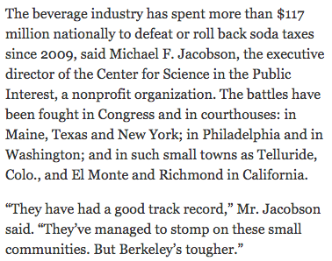
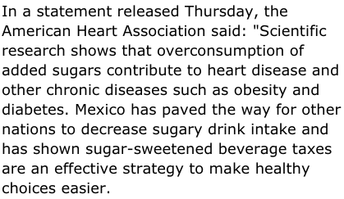
Key Organizations
CSPI – The organization’s influence comes from the wide breadth of articles it was quoted in within this discussion, appearing in 28 different articles.
Organization | Description | Influencer Score
American Beverage Association | Beverage Industry Trade Group | 5957.7
Center For Science in the Public Interest | Nutritional Advocacy Organization | 1846.55
NHS | England’s Health Authority | 1711.2
Teamsters | National Union and Local Chapters | 1477.45
Healthy Food America | Nutritional Advocacy Organization | 1437
World Health Organization | U.N. Health Agency | 1082.45
Health And Human Services | U.S. Health Authority | 991.6
Public Health England | Health Advocacy Organization | 782.95
American Heart Association | Health Advocacy and Research Organization | 651.05
Beverage Association of South Africa | South Africa Beverage Industry Trade Group | 637.4
NAACP | Anti-Discrimination Advocacy Organization | 500.6
Food & Drink Federation | UK Beverage Industry Trade Group | 482.35
Duke University | Private Research University | 419.65
American Diabetes Association | Health Advocacy and Research Organization | 394.9
Action Now Initiative | Health Advocacy Organization | 384.05
Key
Regulators
Health/Social Advocacy Organizations
Industry Spokesperson
Higher-Learning Institutions
American Heart Association – The American Heart Association became an influential backer of the soda tax due to high profile outlets like ABC Australia, Forbes and Christian Science Monitor citing the organization as a predominant health organization involved in the debate.
NAACP – The NAACP was widely cited as proponents of the soda tax, despite its stance in 2013 against the NYC soda tax. Its influencer in the last couple of years has appeared in outlets from the Washington Post to local Berkeley papers.
The American Beverage Association was the second-most influential force behind Mayor Jim Kenney. Health associations across the world added their voices to the debate, but none reached the level of influence of the beverage association.

Slide 9
ABA and CSPI’s Footprint in Public Narrative
 | Institution Primary Mention
● | N/A | 85.2%
● | ABA | 13.3%
● | CSPI | .3%
● | ABA, CSPI | 1.2%
The leading health advocacy organization, CSPI, rarely went unanswered in the press by the ABA. Additionally, ABA was aggressively in the media around the Berkeley and Philadelphia soda tax debates.

Slide 10
Appendix

Slide 11
Methodology of Influencer Analysis
The influence rankings on slides 7 and 8 were completed using the metadata built into Quid and Quid’s entity identification functionality.
After Quid’s algorithms identified where influencers appeared in the communications landscape, Quid analysts used the metadata attached to each article to find an influence score. For this particular analysis, Quid assigned points based on the below metadata:
Source Quality: Quid ranks every outlet in tiers, from 1 (the most-read) to 5 (the least-read). This analysis gave influencers who appeared in Tier 1 outlets ten points, Tier 2 eight points, Tier 3 six points, Tier 4 four points, and Tier Five two points.
Social Shares: Quid assigned points for each social share to recognize that influencers who appear in articles that are shared more often online are likely to be read by and reach more people.
Published Count: The published count reflects the number of times an original article was republished.
The below formula was used to leverage this metadata into an influence score that could be used to rank the key individuals and institutions.
Influence Score = (Sum of Source Quality of All Articles an Influencer Appeared In) + (Sum of Social Shares of Articles x .05) + (Sum of Published Count)

Slide 12
Text Analytics Background

Slide 13
How to Read a Network
Quid creates a visual map to represent the landscape. Example network: sized by degree, colored by cluster.

